Slide 1

Movie Recommendation System
Guide : Swati Gajbhiye
DEPARTMENT OF INFORMATION TECHNOLOGY,
SHAH & ANCHOR KUTCHHI ENGINEERING COLLEGE CHEMBUR, MUMBAI-400088.
Academic Year: 2021-22
Sheetal Gupta TE5-69

Slide 2
Outline
➢Abstract​
➢Problem Statement​
➢Objective​
➢Introduction
➢Literature Survey
➢Comparative Analysis
➢Proposed System
➢​System Requirements
➢Conclusion

Slide 3
Abstract
In this hustling world, entertainment is a necessity for each one of us to refresh our mood and energy. Entertainment regains our confidence for work and we can work more enthusiastically. For revitalizing ourselves, we can listen to our preferred music or can watch movies of our choice.
For watching favourable movies online we can utilize movie recommendation systems, which are more reliable, since searching of preferred movies will require more and more time which one cannot afford to waste.
In this paper, to improve the quality of a movie recommendation system, a Hybrid approach by combining content based filtering and collaborative filtering, using Support Vector Machine as a classifier and genetic algorithm is presented in the proposed methodology and comparative results have been shown which depicts that the proposed approach shows an improvement in the accuracy, quality and scalability of the movie recommendation system than the pure approaches in three different datasets.
Hybrid approach helps to get the advantages from both the approaches as well as tries to eliminate the drawbacks of both methods.

Slide 4
Problem Statement
The goal of the project is to recommend a movie to the user. Providing related content out of relevant and irrelevant collection of items to users of online service providers.

Slide 5
OBJECTIVES & INTRODUCTION
OBJECTIVES
● Improving the Accuracy of the recommendation system.
● Improve the Quality of the movie Recommendation system
● Improving the Scalability.
● Enhancing the user experience.
INTRODUCTION
A recommendation system or recommendation engine is a model used for information filtering where it tries to predict the preferences of a user and provide suggests based on these preferences.
. So, it requires that the movie recommendation system should be very reliable and should provide us with the recommendation of movies which are exactly same or most matched with our preferences.
Recommendation systems have several benefits, the most important being customer satisfaction and revenue. Movie Recommendation system is very powerful and important system

Slide 6
LITERATURE SURVEY:
PUBLICATION & YEAR | TITLE | TECHNIQUE | TECHNOLOGY/ LANGUAGE USED
IEEE 2020 | Analysis of Movie Recommendation Systems | ML Algorithms | Python
IEEE 2021 | Movie Recommendation System Based on Movie Swarm | Frequent pattern mining | Python
IEEE 2019 | Movie Recommendation System Using Semi Supervised Learning | ML Algorithm | Django, Python

Slide 7
Comparative Analysis
❖EXISTING SYSTEM:
Before existence the recommendation system, individuals would physically choose movies to watch from movie libraries.
❖PROPOSED SYSTEM:
In the proposed approach, It has considered Genres of movies but, in future we can also consider age of user as according to the age movie preferences also changes, like for example, during our childhood we like animated movies more as compared to other movies.

Slide 8
SYSTEM REQUIREMENTS
HARDWARE:
A PC with Windows/Linux OS Processor with 1.7-2.4gHz speed
Minimum of 8gb RAM 2gb Graphic card.
SOFTWARE:
Text Editor (VS-code/WebStorm)
Anaconda distribution package (PyCharm Editor)
Python libraries

Slide 9
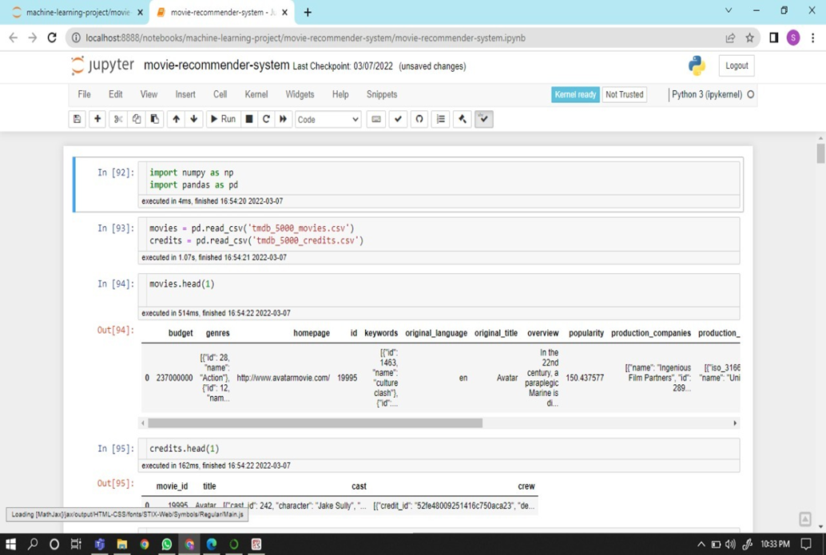
IMPLEMENTATION AND DESIGN:

Slide 10
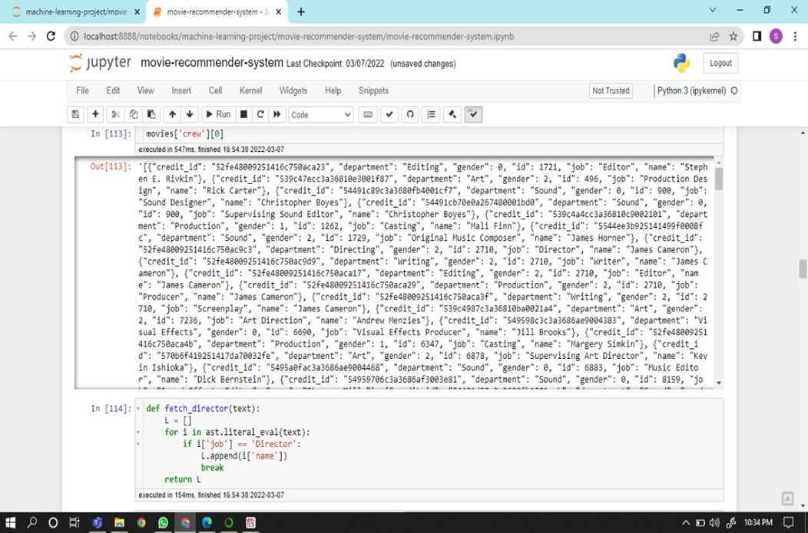

Slide 11
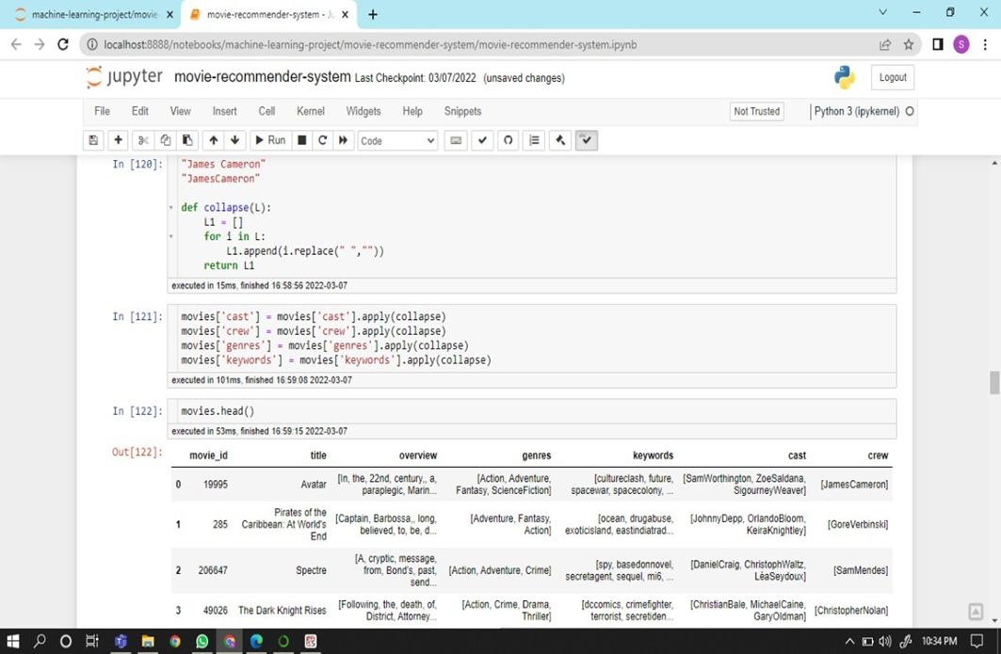

Slide 12
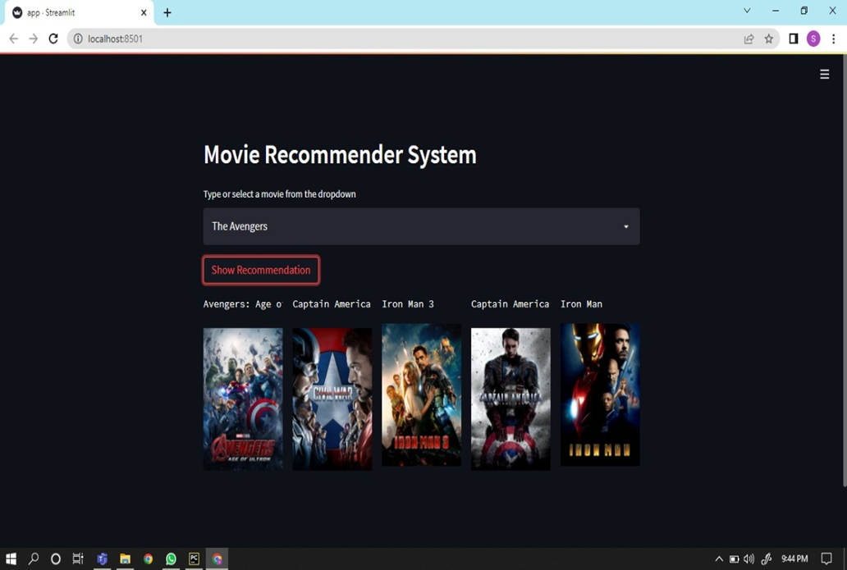

Slide 13
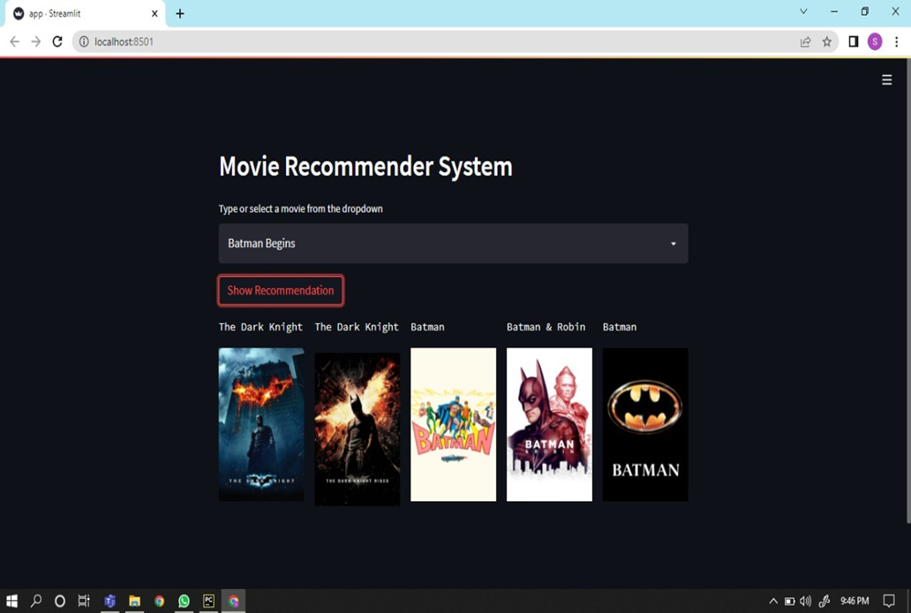

Slide 14
CONCLUSION:
In this project, to improve the accuracy, quality and scalability of movie recommendation system, a Hybrid approach by unifying content based filtering and collaborative filtering; using Singular Value Decomposition (SVD) as a classifier and Cosine Similarity is presented in the proposed methodology. Existing pure approaches and proposed hybrid approach is implemented on three different Movie datasets and the results are compared among them. Comparative results depicts that the proposed approach shows an improvement in the accuracy, quality and scalability of the movie recommendation system than the pure approaches. Also, computing time of the proposed approach is lesser than the other two pure approaches.

Slide 15
Thankyou

